Slide 1
BASICS OF PROGRAMMING

Slide 2

OUTLINE
Programming Fundamentals
Code Components
Designing Using Pseudo-Code
From Pseudo-Code to Runnable Code

Slide 3
PROGRAMMING Fundamentals
BASICS OF PROGRAMMING

Slide 4
Goal And Learning OBjectiveS of This Section
Provide you with fundamental concepts that you can apply to any programming language
Give you insight into what is common across all computer languages
Help you to learn any programming language, through reference to these common fundamentals
Prepare you for your first lab – when you will be designing and implementing computer programs in R and/or Python

Slide 5
Group Discussion
What is computer code?
What is a computer program?

Slide 6
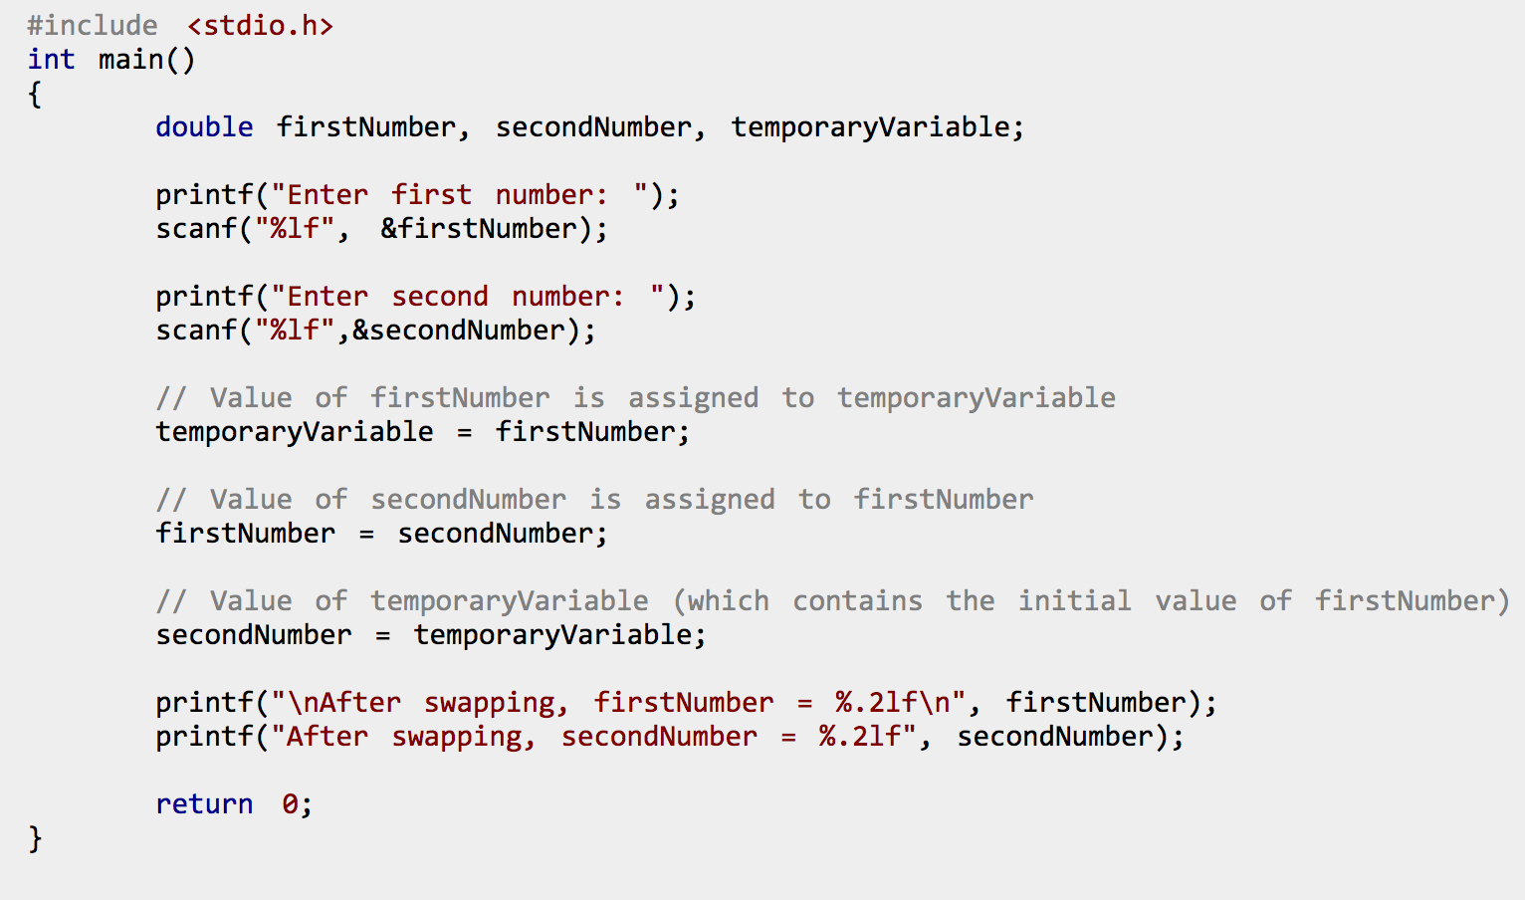
Computer Program: Example in C
An algorithm written in a computer language, providing instructions to a computer for carrying out a series of operations

Slide 7
Computer Program: Definition
An algorithm, written in a computer language, that provides instructions to a computer for carrying out a sequence of operations.
It can be compiled or interpreted as a series of hardware operations, carried out by the electrical components of a computer.

Slide 8
Some Fundamental Concepts
Algorithm
Computer Language
(Formal) Language

Slide 9
Formal LANGUAGE: EXAMPLE
Alphabet: {‘a’, ‘b’, ‘C’, ‘D’,’!’}
Rules (Grammar):
letters may be placed to the left or right of another letter
a letter instance must always have another instance of the same letter to either the left or the right
upper case letters must always have a lower case letter to the left or right

Slide 10
Formal LANGUAGE: DEFINITION
In a formal language:
words are created from a pre-defined alphabet
a grammar provides rules about how letters may be combined to form words

Slide 11
Computer Language: Definition
A (formal) language constructed to provide instructions to a computer, such that it can be compiled into low-level instructions that the computer processor can carry out.

Slide 12
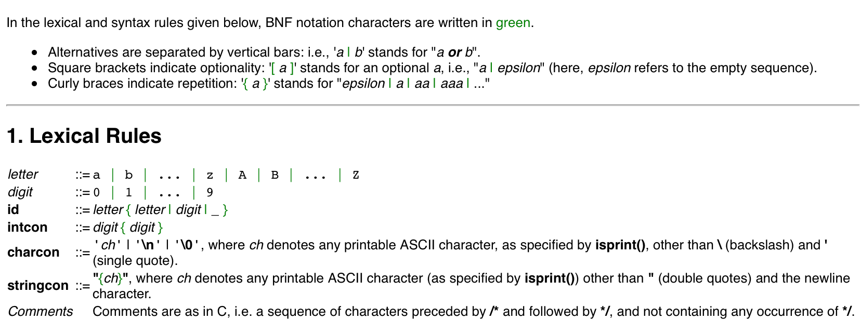
Computer Language: FORMAL DEFINITION OF C
A language constructed to provide instructions to a computer

Slide 13
Computer Program: Definition
An algorithm, written in a computer language, that provides instructions to a computer for carrying out a sequence of operations.
It can be compiled or interpreted as a series of hardware operations, carried out by the electrical components of a computer.

Slide 14
Algorithm: Example
Pour ½ cup flour into bowl
Break one egg into bowl
Pour 3 tablespoons oil into bowl
Pour 1 teaspoon baking powder into bowl
Mix with spoon until smooth
Pour mixture into muffin tins
Bake for 15 minutes at 350 degrees Fahrenheit

Slide 15
Algorithm: Definition
A sequence of instructions which have one or more well defined stopping points.

Slide 16
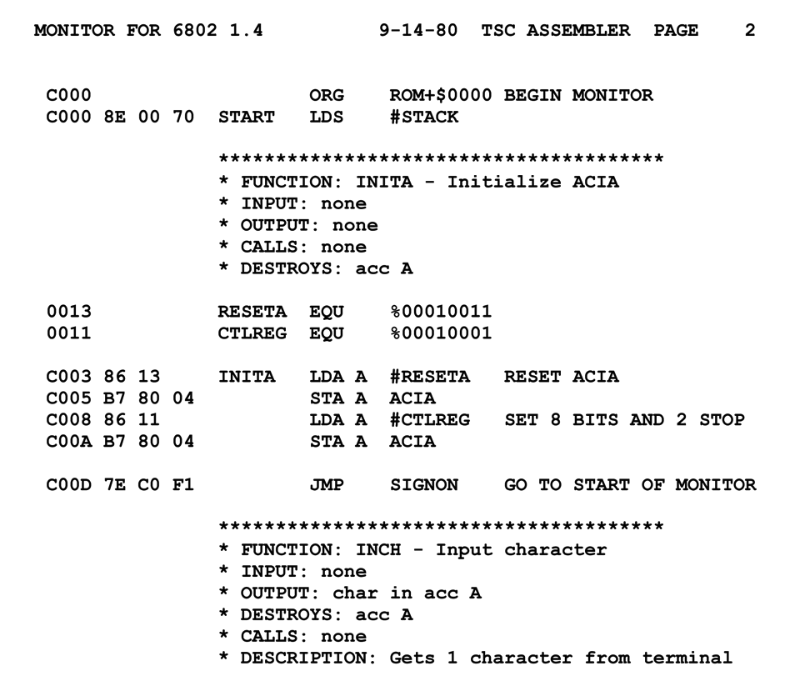
Computer Program: Details
Higher level computer languages are compiled into (or interpreted as) ‘machine code’ – a series of very basic instructions that tell the computer hardware how to behave.
When the computer is carrying out the instructions, we say it is ‘running’ the program – as a process
We can instruct a computer to run a program. Computers can also tell themselves to run programs!

Slide 17
Computer Programs: The Big PICTURE
All computers operate by running (compiled) computer programs.
The internet is a collection of computers connected by physical wires or radio wave transmitters and receivers.
Computers transmit to, and receive signals from, other computers on this network.
The signals sent from computer to computer, and what is done with received signals, are based on what programs the computers are running.
The cloud is a part of the internet loosely defined as a collection of computers used mainly to store and serve content to other computers.

Slide 18
CODE COMPONENTS
BASICS OF PROGRAMMING

Slide 19
Group Discussion
What are the fundamental elements of computer code?

Slide 20
Elements of Computer Code
Variables
Data Structures
Operators
Statements and Expressions
Blocks (and Scope)
Functions
Logical (Control) Flow
Libraries/Packages/Modules
Inputs/Outputs
Interpreters/Compilers

Slide 22

Ready to Start Programming???
Not so fast!

Slide 23
Designing Code (Using Pseudo-Code)
BASICS OF PROGRAMMING

Slide 24
Group Discussion
What does it mean to design an algorithm, or a program?

Slide 25
Design Components
In designing an algorithm, we need to specify:
input
output
how the input should be transformed to provide the output
From a bigger picture perspective, we can also talk about the function, or purpose of the algorithm.

Slide 26
Pseudo-code: EXAMPLE
j_cluster(array_of_points, max_n_neighbour_distance)
{
for each point[i] in array_of_points
{
for each remaining point[j] in array_of_points
{
distance_between_ij = distance(point[i], point[j])
if distance_between_ij <= max_n_neighbour_distance
then neighbours[i] = add_to_neighbours(point[i],point[j])
}
. . .

Slide 27
PseudoCode: What It Really Looked Like!

Slide 28
Pseudo-code: Description
Pseudo-code is the term for a rough sketch of an algorithm which indicates the general expected input, output and steps, but which ‘black boxes’ the details of the functions.
Keeping in mind the main elements of any computer language (e.g. variables, functions, logical flow, etc.) we can design an algorithm without using a specific language.

Slide 29
Pseudo-code: Strategy
Define an input
Define an output
Write a set of programmatic instructions that will take you from input to output
Remember that you can ‘black box’ parts of the code – describing functionality at a high level

Slide 30
Pseudo-code: LEVEL OF Abstraction
Getting a feel for the right level of detail in pseudocode takes practice.
To some extent, it depends on the level of abstraction of the programming language you will (likely) be using:
High-level languages – have a lot of built in functions
Low-level languages – many details and functions must be programmed ‘by hand’
High-level languages let you program at a higher level of abstraction.
At the same time, you may sacrifice utility for understanding.

Slide 31
Exercise in Pseudo-code AND ALGORITHM DESIGN: SORTING
Your input is a list of numbers in unknown order
Your output is the same list of numbers sorted in the right order
Write pseudo-code that will take you from input to output
Remember that you can ‘black box’ parts of the code – describing functionality at a high level
In terms of level of detail – take into account the manipulation of individual numbers or groups of numbers within the list.

Slide 32
From Pseudo-CODE to Runnable Code
BASICS OF PROGRAMMING

Slide 33
The Real Deal
To go from pseudo-code to real code, there are a number of steps:
Determine the appropriate syntax of the language you want to use and rewrite your pseudo-code as real code in this language
Replace black box functions with real code
Determine how to connect your piece of code (the software) up to the computer, so your code can be compiled/interpreted, run by the computer, receive input and generate output
PSEUDO-CODE
CODE-CODE

Slide 34
From Code To Computer
Many roadblocks can arise when going from code – which is just text files – to having code that runs on your computer. These roadblocks can include:
libraries
input/output + file system
compilers/interpreters
In broad terms, a certain amount of infrastructure must be in place!
We are taking care of much of this for you by setting up notebooks for you.

Slide 35
Programming Resources
Much of the information about how to use a particular computer language or how to make code run on a particular hardware configuration, is not written down in any single authoritative reference manual.
This is likely because the world of coding and computers changes so quickly.
To successfully code, you must be embedded in a community of coders. Luckily, the internet has made this much easier – most questions about coding have already been answered somewhere on the internet.
In short – STACK EXCHANGE (and other similar sites)

Slide 36
Sorting Algorithm: A Sketch in R
Your challenge: Using the provided R notebook, write (in R) and run a program that sorts numbers.

Slide 37
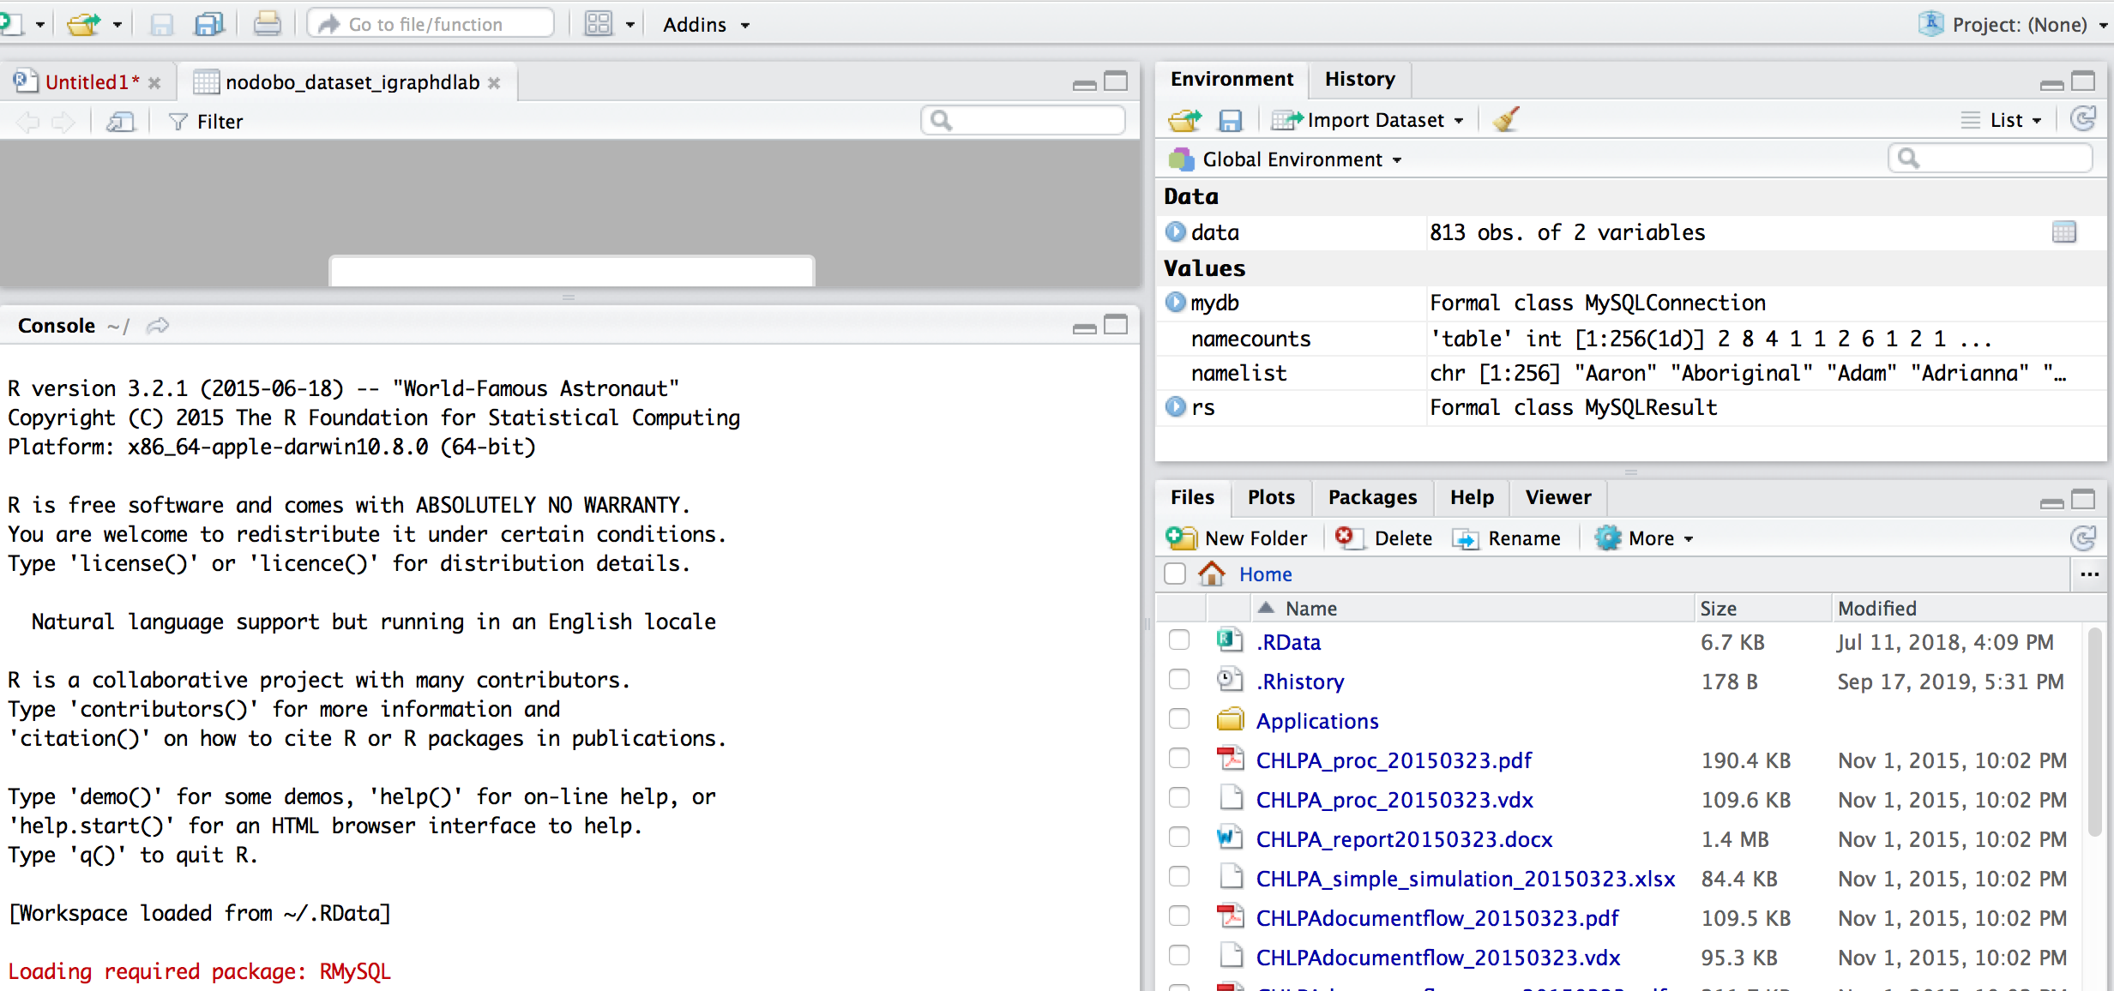
R STudio

Slide 38
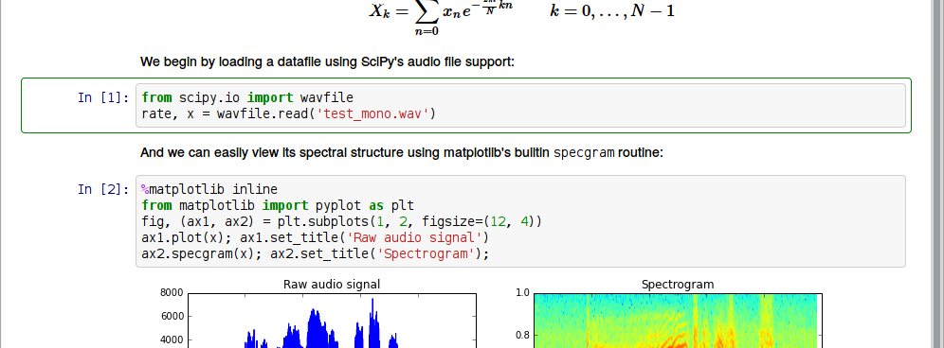
Jupyter Notebook Anatomy

Slide 39
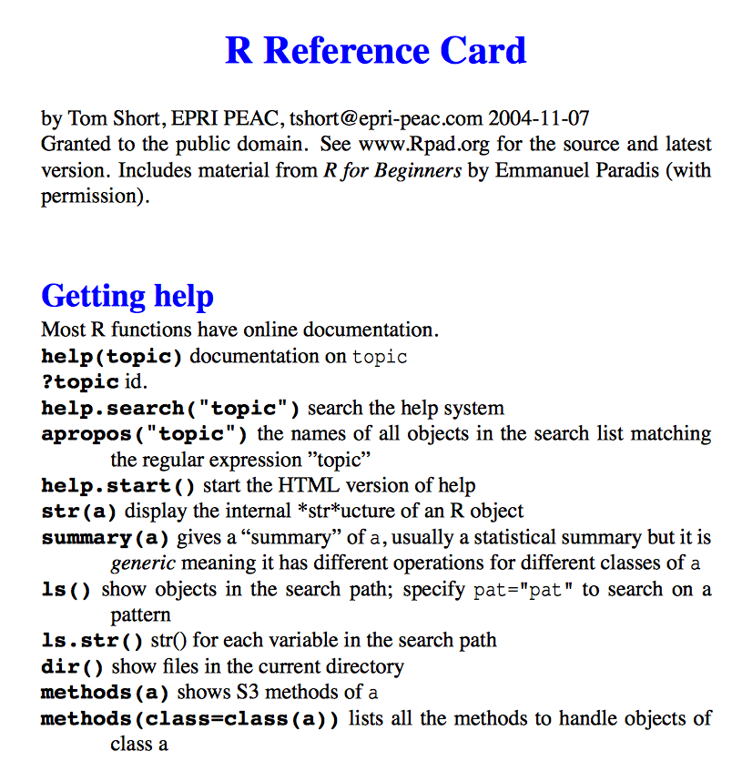
Components of R Computer Code
Variables
Data Structures
Operators
Statements and Expressions
Blocks (and Scope)
Functions
Logical (Control) Flow
Libraries/Packages/Modules
Inputs/Outputs
Interpreters/Compilers

Slide 40
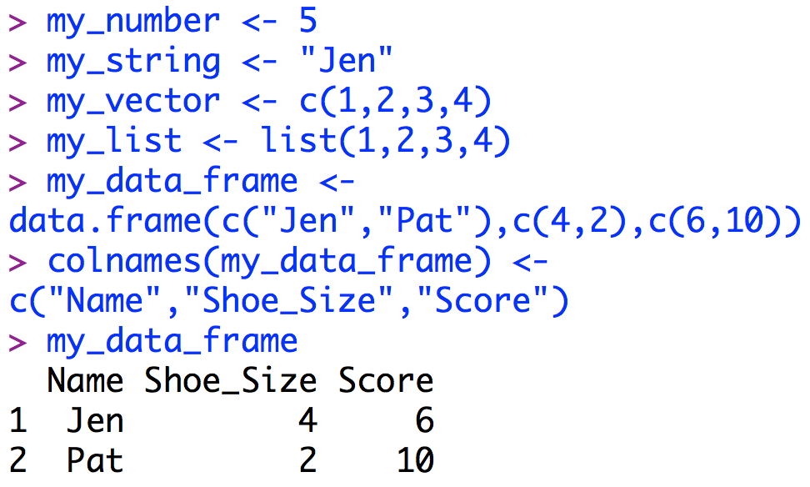
R: Some Key INFO (I)
To create a variable in R, simply come up with a name and use the assignment operator to assign a value to the variable
The value might be of variable types: number, character, string, vector, list, matrix, data frame or some other object
R uses the data frame object a lot!

Slide 41
Object Oriented vs Procedural Languages
R and Python are objected oriented languages, as opposed to procedural languages.
What does this mean?
To understand the answer we must first understand:
Data Types
Data structures
Functions

Slide 42
Data Types
Languages have a set of built in basic variable types – e.g.:
Integer: 5
Character: ‘m’
List: (5, 3, 9)
Other variables types can be built up out of these basic types – e.g.:
String = list of characters: (‘t’, ‘a’, ‘b’, ‘l’, ‘e’)

Slide 43
Data StructureS and Objects
A user might want to define their own set of related variables – a data structure:
struct myNames = {string firstName, string middleName, string lastName}
jenNames might be a variable of type myNames, with firstName = Jen, middleName = Adele, lastName = Schellinck
In addition a programmer might want to always be able to carry out a set of predefined instructions, or functions, on that data structure:
jenNames.print_middle_name
An object is loosely defined as a user defined data structure plus a set of functions that goes along with that data structure.

Slide 44
R data Frames
The data frame object in R is structured similar to a spreadsheet in Excel:
It has rows and columns, with associated row and column names
You can carry out predefined operations on specific values, on selected rows or selected columns
People familiar working with databases, AND people used to working with more vector-focused languages (e.g. Java) might find the data frame implementation in R frustrating!

Slide 45
Sorting Algorithm: A Sketch in R
Your challenge: using the provided R notebook, write (in R) and run a program that sorts numbers.

Slide 46
Sorting Algorithm: A Sketch in Python
Your challenge: using the provided Python notebook, write (in Python) a program that sorts numbers.

Slide 47
Some Useful Additional Details

Slide 48
Compiled vs Interpreted Languages
Compiled Language: Program is written as a whole, compiler checks the code as a whole and turns it into a low level language
Interpreted Language: Interpreter reads, turns into low-level code, and carries out one statement at a time.
Using an interpreter lets you program in a more free-form, improvisational way – like playing jazz instead of classical music.
This can be useful if you are doing exploratory work, but you can run into trouble if you use this strategy to generate larger or more substantial programs.

Slide 49
Debugging
Debugging is mostly about revealing what is in memory at different points in the control flow of the code – is the code doing what you think it is?
Debugging is a bit of an art form
Debugging requires you to be a detective
Debugging teaches you perseverance
There are debugging tools that can help you all of this

Slide 50
Some Relevant Computer Science Frameworks
Languages (Computer, Mark Up)
Libraries/APIs
Software (Applications, Utilities, Systems)
Code (Open-Source, Uncompiled)
Protocol/Standard
Programming Models/Styles

Slide 51
Optional EXERCISES And READINGS
BASICS OF PROGRAMMING

Slide 52
Exercises: LabS Coming Up!
In the next session, you will have the opportunity learn more about R and Python and to run some pre-made notebooks.
Starting in February, you will be having labs, where the programming responsibility will fall to you.
Prior to these labs, for out-of-class work we encourage you to:
Review the ‘Introduction to R’ notebook
Review the introductory Python notebooks
Try writing R and Python statements and ‘code snippets’ in the Notebook environment, in order to become comfortable with R and Python

Slide 53
Optional Exercises: Try It OUt
Starting from an empty (new) notebook:
Load some data from a file into a data frame
Create a plot or graph using some of the loaded data
Note – using code from other notebooks or from on-line resources is not cheating!

Slide 54
REFERENCES
BASICS OF PROGRAMMING

Slide 55
References
Sample of C language specifications: https://www2.cs.arizona.edu/~debray/Teaching/CSc453/DOCS/cminusminusspec.html
C code snippet: https://www.programiz.com/c-programming/examples/swapping
Cheat Sheet for Jupyter Notebooks: https://s3.amazonaws.com/assets.datacamp.com/blog_assets/Jupyter_Notebook_Cheat_Sheet.pdf
Cheat sheet for R: https://cran.r-project.org/doc/contrib/Short-refcard.pdf
Cheat sheet for Markdown: https://scottboms.com/downloads/documentation/markdown_cheatsheet.pdf

Slide 56
Images
Signpost: https://upload.wikimedia.org/wikipedia/commons/2/29/Worden_park_signpost.jpg
Muffins: https://commons.wikimedia.org/wiki/Category:Muffins#/media/File:Sweet_potato_pecan.jpg
Assembly Language: https://en.wikipedia.org/wiki/Assembly_language#/media/File:Motorola_6800_Assembly_Language.png
Internet Map: https://upload.wikimedia.org/wikipedia/commons/d/d2/Internet_map_1024.jpg

